Slide 1
Embracing New Opportunities for Club Extension Growth
Dave Cook
D6000 DGN & Membership Chair
March 24, 2023

Slide 2
Overview of Our Discussion
First a caveat - there may be differences between your district and D6000 regarding satellites. Check with district leadership.
Second, each of us is being challenged to help our clubs grow.
And, while we live in a very complicated world, sometimes we make growing clubs harder than it needs to be.

Slide 3
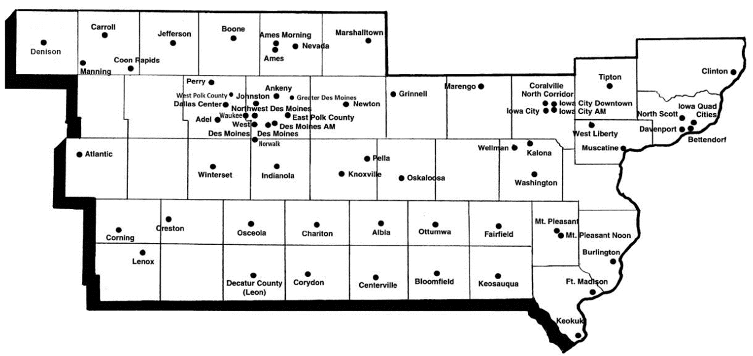
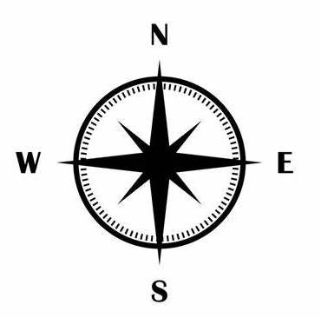
Rotary District 6000 Overview
66 Clubs in southern Iowa with 3,140 Members

Slide 4
Rotary Membership Among Women & Men
 | Women | Men
Rotary U.S. | 34% | 66%
District 5580 | 37% | 63%
District 5870 | 34% | 66%
District 5950 | 33% | 67%
District 5960 | 35% | 65%
District 5970 | 36% | 64%
District 6000 | 33% | 67%
Data as of 3/13/23

Slide 5
Membership Among Younger Adults
 | 18 to 49
U.S. Zone 29 | 24%
Among those reporting.

Slide 6
Two fundamental truths we believe will grow and strengthen clubs for the future.
Striving for greater membership parity among men and women is key to our future growth. Growth among adults 18 to 49 is critically important.
Clubs that offer more than one meeting time to accommodate different work schedules and varying family responsibilities are more likely to grow - especially among women and men 18 to 49.

Slide 7
Fastest Growing Clubs in D6000
1. Bettendorf | +31% |  | 11. Clinton | +10%
2. Adel | +29% |  | 12. Johnston | +10%
3. Boone | +18% |  | 13. Waukee | +10%
4. Marshalltown | +16% |  | 14. Albia | +10%
5. Perry | +14% |  | 15. Iowa City Dntwn | +10%
6. West Liberty | +14% |  | 16. Winterset | +7%
7. Dallas Center | +13% |  | 17. Nevada | +5%
8. Ankeny | +12% |  | 18. Coralville NC | +4%
9. West Des Moines | +11% |  | 19. Pella | +4%
10. North Scott | +10% |  | 20. Keosauqua | +4%
Already Have a Satellite Club Extension
Launching Satellite Club Extension
Membership growth from 7/1/21 to 7/1/22

Slide 8
Clubs with Satellite Extensions are among the Fastest Growing in D6000!
Membership in clubs with established satellite extensions increased an average of 9% last year.
Of the 135 new Rotarians who joined the 25 clubs who grew last year, 39% joined 6 clubs with satellite extensions.
Strong growth among clubs with satellite extensions helped D6000 lead the 16 Rotary districts that make-up Zone 29 last year.

Slide 9
Definition of a Satellite has Changed
In the past, a satellite was a short-term, transitional club the sponsoring club believed would charter to become a independent Rotary club within 3 years.
Today, a satellite is simply an alternate meeting time for a club. Members are full Rotarians in the host club and many have no future plan to charter.
The term satellite can be polarizing. In D6000, we now call them club extensions.

Slide 10
Two Club Extension Strategies are Gaining Significant Momentum in D6000
One Club that Meets at Two Different Times
One Club that Meets at Two Different Locations

Slide 11
5:30 to 6:30 is the Golden Hour for Club Extensions
Members come to Rotary after work and are still home for dinner & evening activities.
It’s preferred meeting time for parents of school-aged children, working moms, teachers, retailers and younger professionals.
No meal is served so membership costs less.

Slide 12
History of D6000 Club Extension Expansion
26% of clubs in D6000 now have a club extension & more are coming!
2013-14
Ankeny
2018-19
Boone
2020-21
Nevada
2021-22
Marshalltown
Clinton
Iowa City AM
W Des Moines
2022-23
Ames
Davenport
Bettendorf
West Liberty
Knoxville
Winterset
Tipton
Indianola
North Liberty¹
Jefferson
North Liberty will be second location club extension for Rotary Club of Coralville-North Corridor.

Slide 13
Other Factors Driving Club Extension Growth
Because it’s a club extension, members are included in host club membership numbers.
Having two meeting options is a big advantage for prospective members.
Snacks are usually provided and beer & wine are often available for purchase.
Younger professional couples often attend together.
Spouses of current members are often first to join.

Slide 14
Other Factors Driving Club Extension Growth
Most club extensions meet twice a month (1st & 3rd Thursday, 2nd & 4th Tuesday, etc.)
Common for club members to attend both meetings.
RI recognizes one President per club. Leader of extension is often referred to as The Chair.
Most clubs maintain one board that includes club extension representation.
Finally, the decision to start a club extension does not require RI approval.

Slide 15
Typical Club Member Quarterly Billing Comparison
 | Traditional Member Quarterly Billing | Satellite Member Quarterly Billing
RI & District Dues | $50.00 | $50.00
Meals @ $12.00 ea. | $144.00 | $0.00
Total | $194.00 | $50.00
For most clubs, the only difference between quarterly billing for traditional members and satellites members is the cost of meals.

