Slide 1
Leading vs Managing
April 24, 2023
Title Page Option

Slide 2
introduction
Jeff Hassman
Rotarian since 2008
Rotary Foreign Exchange Student to the Netherlands in 1988-89
Rotaract President 1991-2
Club President for Cedar Falls Rotary Club in 2017-18
District Governor for D5970 in 2021-22
Facilitator for Emerging Leaders session at Zone Institute
Owner of over a dozen companies and investments
Married to Maripili with 4 adult children

Slide 3
What is Leading?
What is Managing?

Slide 4
Leadership: What is it?
Leadership is the creation of positive, non-incremental change, including the creation of a vision to guide that change – a strategy – the empowerment of people to make the vision happen despite obstacles, and the creation of a coalition of energy and momentum that can move that change forward. – John Kotter

Slide 5
Management: What is it?
Management is getting the confused, misguided, unmotivated and misdirected to accomplish a common purpose on a regular, recurring basis. – Joe Fuller

Slide 6
Leadership vs management quotes
“Management is doing things right; leadership is doing the right things.” – Peter Drucker
“Management works in the system; leadership works on the system.” – Stephen Covey
“Management is about persuading people to do things they do not want to do, while leadership is about inspiring people to do things they never thought they could.” – Steve Jobs
“A manager says go. A leader says let’s go.” – John Maxwell

Slide 7
Club president
As Club President what should you be?
Leader
Manager
You will need both traits but
Leading will make a difference

Slide 8
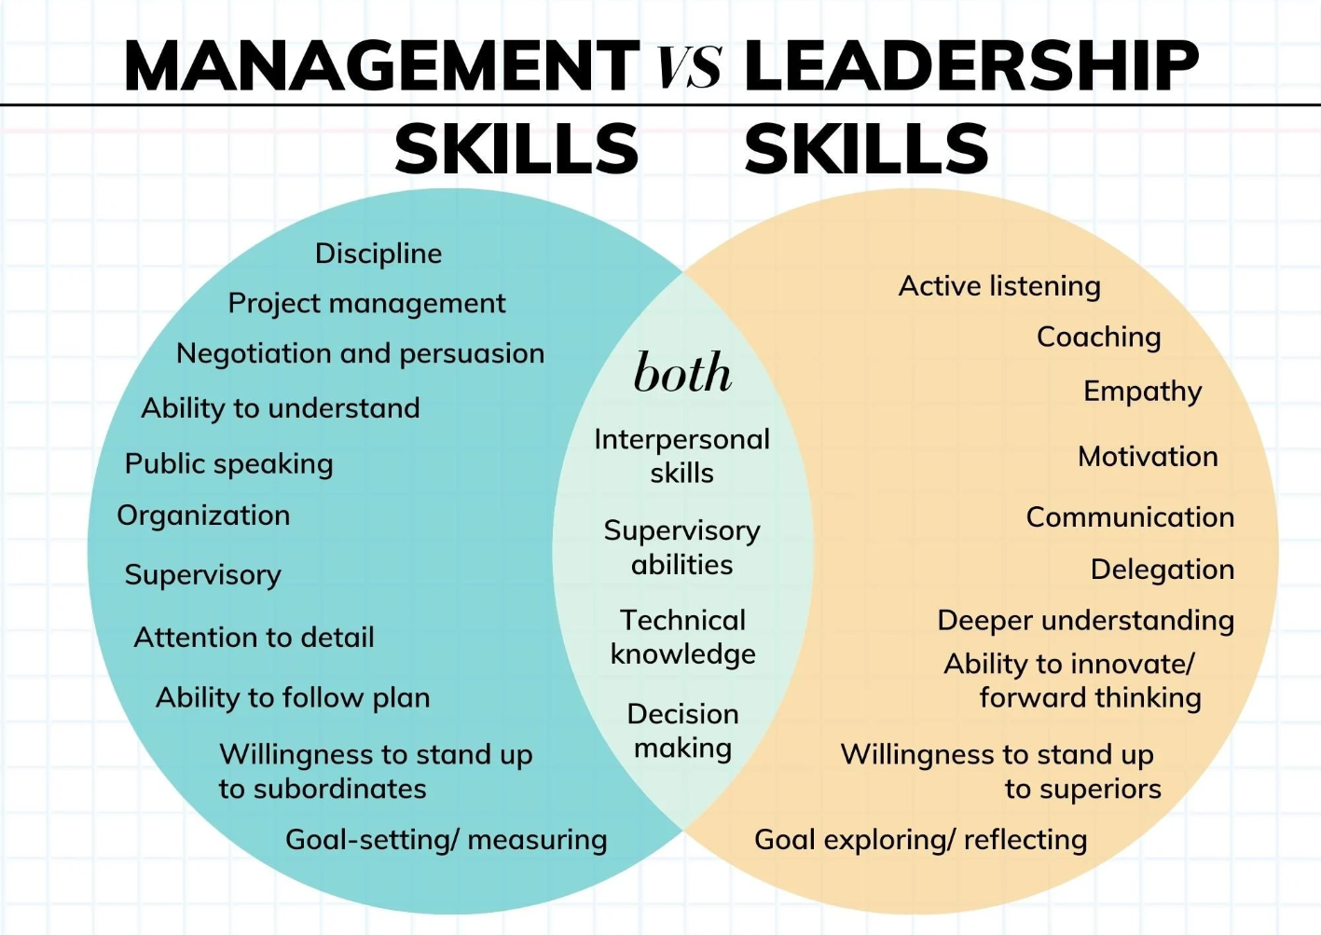
Skill differences

Slide 9
Club President as manager
Assigns committee heads and members to committees
Sets the agenda
Ensures good programs
Runs meetings smoothly
Sets the annual membership and fundraising goals for the club
Coordinates with District Governor and Assistant Governors
Has a “My Rotary” account and updates as necessary
Works with treasurer to create a club budget

Slide 10
Club President as Leader

Slide 11
Leadership: What is it?
Leadership is the creation of positive, non-incremental change, including the creation of a vision to guide that change – a strategy – the empowerment of people to make the vision happen despite obstacles, and the creation of a coalition of energy and momentum that can move that change forward. – John Kotter

Slide 12
Leadership traits
Positive Change
Vision
Strategy
Empowerment
Coalition

Slide 13
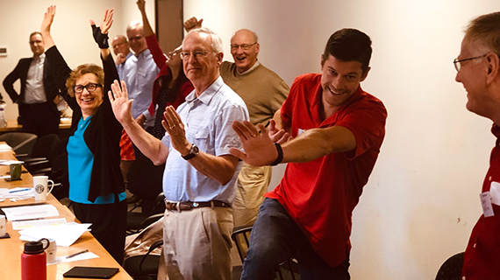
Positive change
External
Public perception of your club
Identify and address a community need
Partner with another non-profit
Apply for a local or global grant
Promote the Rotary brand
Internal
Meeting format
Membership types
Engagement opportunities
Rotate leadership positions
Have fun

Slide 14
vision
Where are you?
Conduct a membership survey
Identify your club’s strengths and weaknesses
“Benchmark” your club with other clubs
Where should you go:
Vision casting: What could the club look like in 5 years?
Define success: How will we know we have reached the vision?
Align the vision to the Rotary global vision

Slide 16
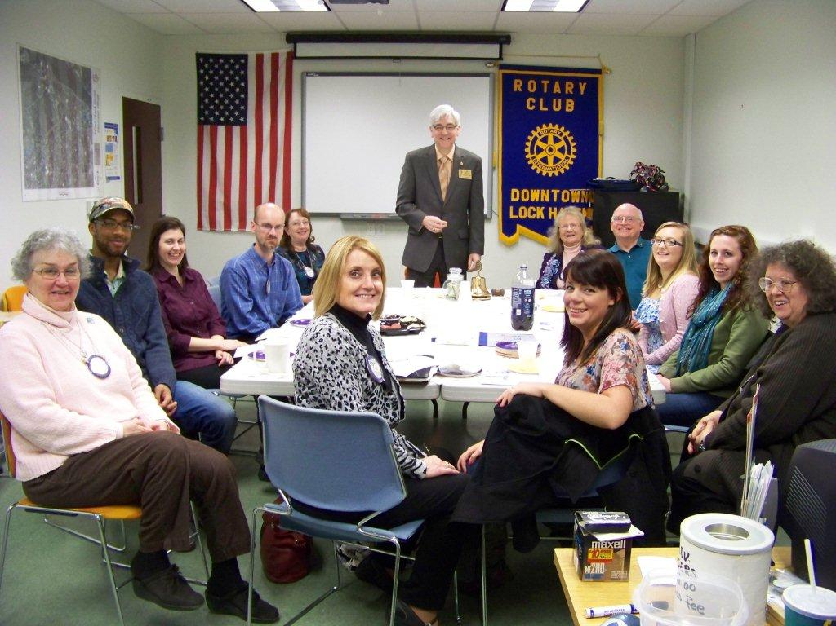
Strategy
Define how to achieve the vision:
Resources needed
Goals- make sure they are SMART
Establish milestones
Define priorities- what should we do first
Get your board on board
Create a continuity of leadership
Keep it simple

Slide 17
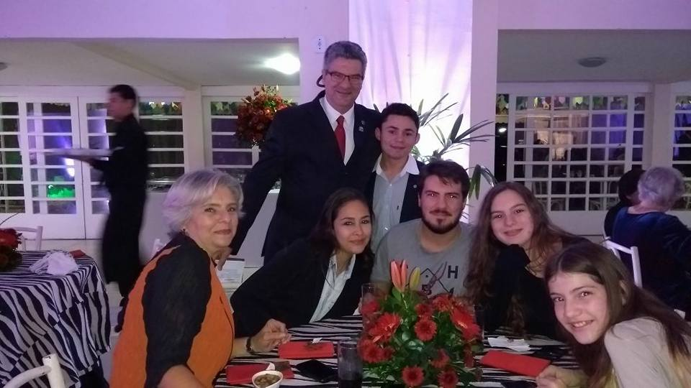
Empowerment of people
Develop leaders in your club
Increase member engagement
Rotate committee assignments
Social and networking opportunities
Develop relationships in the club
Identify and encourage newer members to step up
Let them try new ideas - change
Mentorship opportunities
Pair a new member with an existing member

Slide 18
Build a coalition
Team building
Open brainstorming will improve ideas
Create a sense of ownership
Delegate tasks and responsibilities
Create energy and momentum
Alone you go fast, together you go far

Slide 19
How can I prepare to be a leader?

Slide 20
Club president guide
Take a self assessment
Strengths Finder 2.0 (Gallup.com) for $60
Ideally find a Strengths Coach to help you interpret the results
Focus on your strengths and be aware of your blind spots
Contact your District Governor and Assistant Governor for support
Have a “life-line” to a couple of other club presidents
Online Resources
Rotary Club Health Check
Strategic Planning Guide
Rotary Club Central
Member Satisfaction Survey
Online membership courses in the Learning Center
The Brand Center
Introducing New Members to Rotary
Leadership in Action: Your Guide to Starting a Program
Take these steps now before July 1

Slide 21
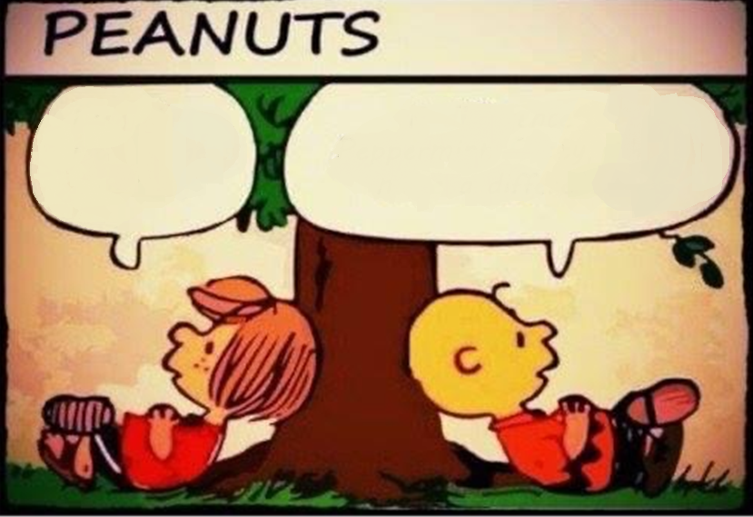
You get to make a difference!
I wonder what Club Presidents make?
A difference, Peppermint Patty, they make a difference!

