Slide 1


Slide 2
What is the BEST fundraiser
you’ve attended?
Title Page Option

Slide 3
What is the WORST fundraiser
you’ve attended?

Slide 4
subhead
FUNDRAISE FOR A PURPOSE

Slide 5


Slide 6
subhead
FUNDRAISE WITH A PLAN

Slide 7
Build a Plan
Who is your on your fundraising team?
What are you fundraising for?
How much do you want to net?
Who is your audience?
What experience do you want for guests?
What will make your event unique?
How much can your audience afford?
What is your expense budget?
Clarity improves effectiveness and engagement.

Slide 8
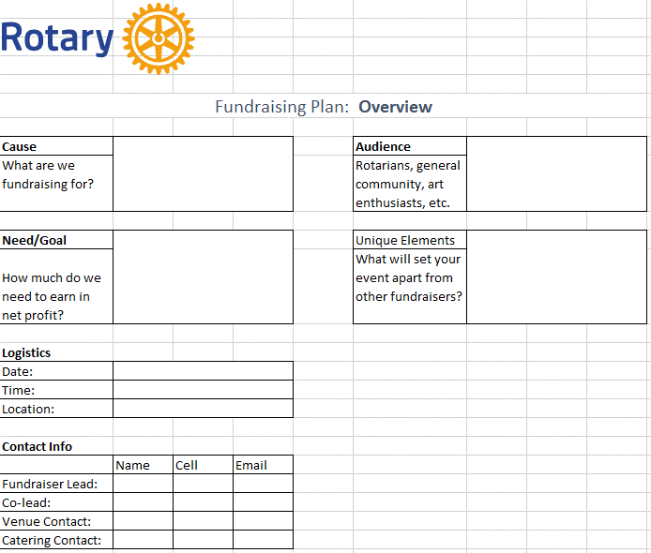

Slide 9
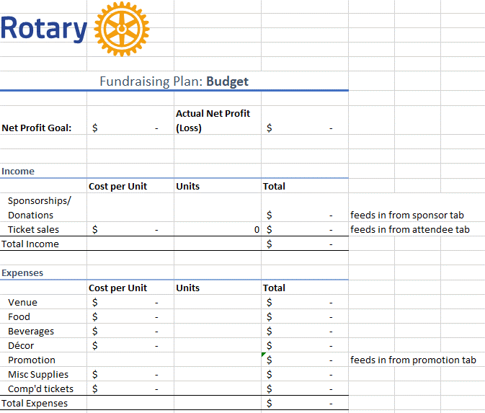

Slide 10
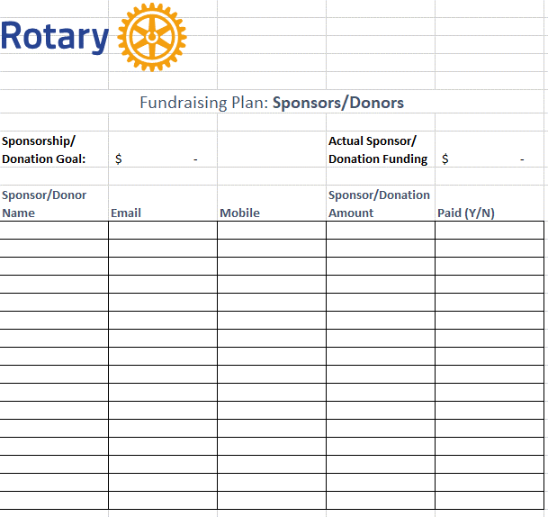

Slide 11
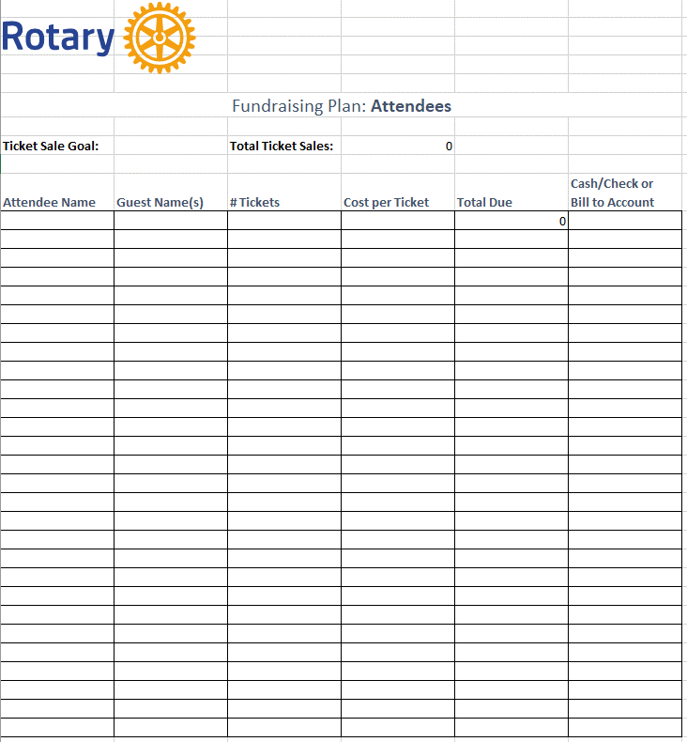
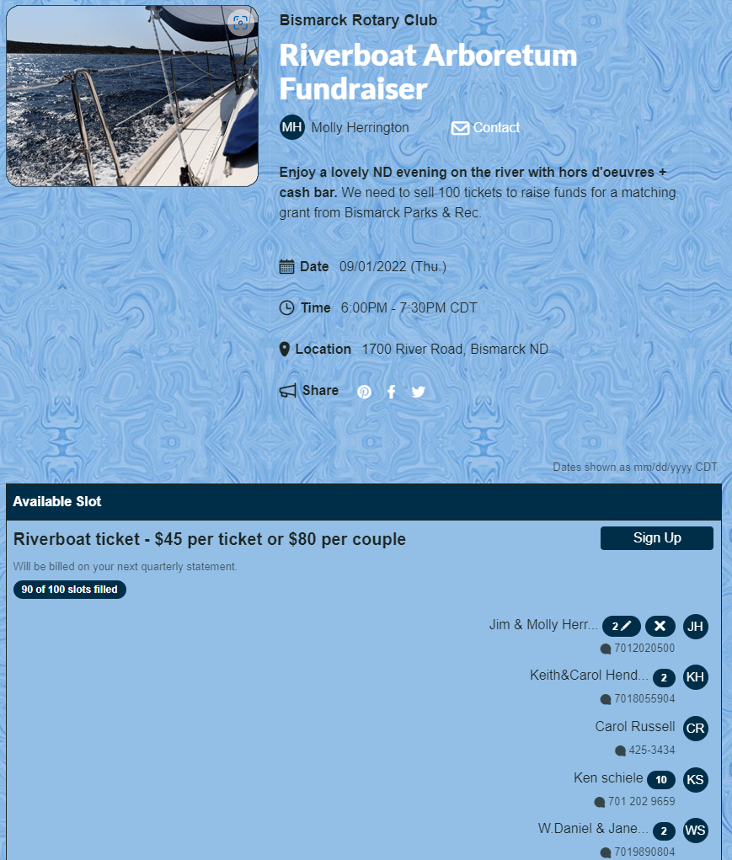

Slide 12
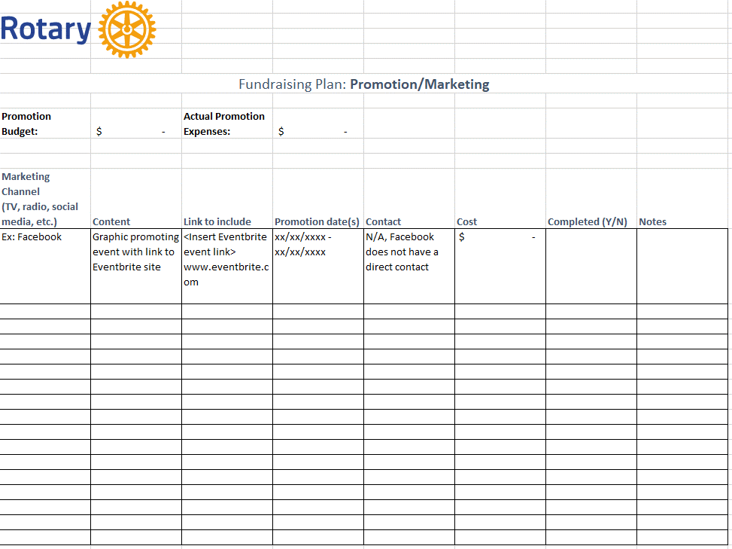

Slide 13
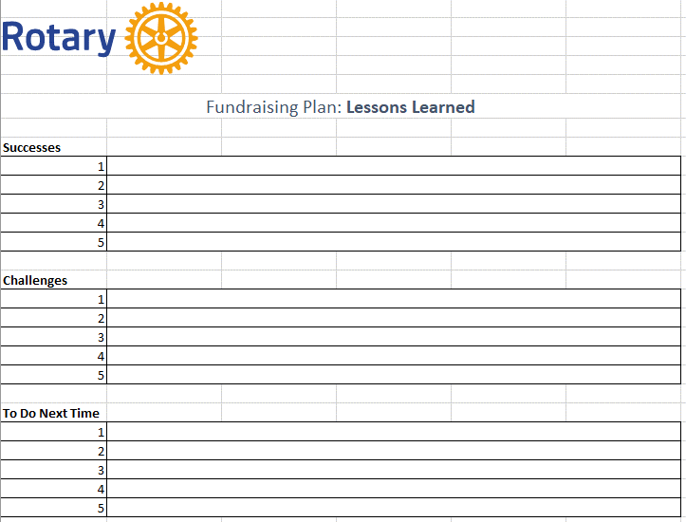

Slide 14
subhead
FUNDRAISE TO MAXIMIZE IMPACT

Slide 15
Global Grants
support large international projects with long-term, sustainable outcomes in one or more of Rotary’s areas of focus. They range from $30,000 to $400,000.
Access Rotary Grants
Can you stretch the money raised?
District Grants
fund smaller-scale, short-term projects that address immediate needs in your community or abroad.

Slide 16
DISCUSSION

Slide 17
What TOOLS do you use
in fundraising?
Title Page Option

Slide 18
How have you successfully
driven ATTENDANCE to your
fundraisers?

Slide 19
subhead
What is ONE fundraiser
you would like to try?

Slide 20
THANK YOU
Molly Herrington
Bismarck Rotary Club, D5580
Molly.j.Herrington@gmail.com

